Slide 1
COMP 53 – Week Ten
Copy Constructor / Destructors
Stacks and Queues

Slide 2
Topic Review
Complete Lab 7 (If Needed)
Double Linked List Review
Printing / Traversing

Slide 3
What We’ve Covered So Far
Data Structures
Linear
Direct Access
Sequential Access
Nonlinear
Hierarchical
Array
List
Stack
Queue
Hashtable
Tree
Heap

Slide 4
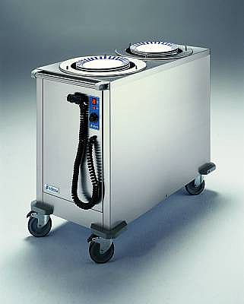
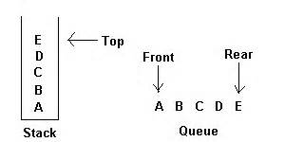
Topics
Copy → Paste → Delete
Copy Constructors and Destructors
Stacks
Queues

Slide 5
Why Do We Care
Need to clean up after ourselves.
Automate the copy process
Stacks – Manage data in unique ways
Queues – Get in Line! Alternate way to manage linked list

Slide 6
Shallow and Deep Copies
Shallow copy
Assignment copies only member variable contents over
Default assignment and copy constructors
Deep copy
Pointers, dynamic memory involved
Must dereference pointer variables to "get to" data for copying
Write your own assignment overload and copy constructor in this case!

Slide 7
Copy Constructors
Automatically called when:
Class object declared and initialized to other object
When function returns class type object
When argument of class type is "plugged in" as actual argument to call-by-value parameter
Requires "temporary copy" of object
Copy constructor creates it
Default copy constructor (which is automatic)
Like default "=", performs member-wise copy
Pointers → write own copy constructor!

Slide 8
What If You Copy a List Object?
LinkedList
7
8
11
LinkedList

Slide 9
Copy Constructor Format
Similar to regular constructor
Except that there is a single parameter
Data type is the class
Pass by Reference
Example
LinkedList(LinkedList& l)

Slide 10
Copy Constructor Code
LinkedList::LinkedList(const LinkedList &copyFrom) {
if (copyFrom.head == NULL)
return;
Node *from = copyFrom.head;
head = new Node(from->getData(), NULL);
from = from->getNext();
Node *to = head;
while (from !=NULL) {
to->setNext(new Node(from->getData(), NULL));
to = to->getNext();
from = from->getNext();
}

Slide 11
Copy Constructor Practice
Add the copy constructor to the linked list project
Model code after previous slide

Slide 12

Enter the Destructor!
Dynamically-allocated variables do not go away until "deleted"
Private member pointers
Dynamically allocate "real" data (in constructor or insert)
Must "deallocate" when object is destroyed
Opposite of constructor
Automatically called when object is out-of-scope
Default version only removes ordinary variables, not dynamic variables
Defined like constructor, just add ~

Slide 13
Destructor Code
Never have input parameters
LinkedList::~LinkedList() {
Node *discard;
while (head != NULL) {
discard = head;
head = head->getNext();
delete discard;
}
}
Advance to next item in list prior to delete

Slide 14
Destructor Practice
Add the destructor method to linked list project
It needs to go through the list and delete each node
Main() should create a variable within a scoping block
When scope is exited, the destructor should fire
Add a cout statement in destructor as “proof”
Also when main() exits, it should trigger the destructor

Slide 15
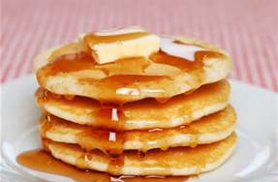
Stacks
Stack data structure:
Retrieves data in reverse order of how stored
LIFO – last-in/first-out
Think of like "hole in ground“ or “stack of pancakes”
Stacks used for many tasks:
Track C++ function calls
Memory management
Our use:
Use linked lists to implement stacks
Note – we do not SEARCH a stack

Slide 16
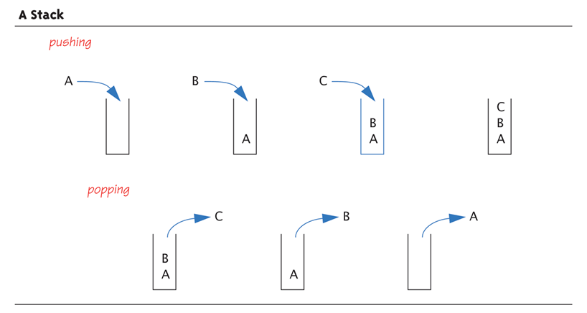
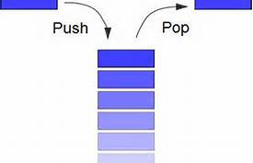
Stack Operations
Adding data item to stack → push. "pushing" data onto stack goes to "top" of stack
Removing data item from stack → pop. "popping" item off stack removes from "top" of stack

Slide 17
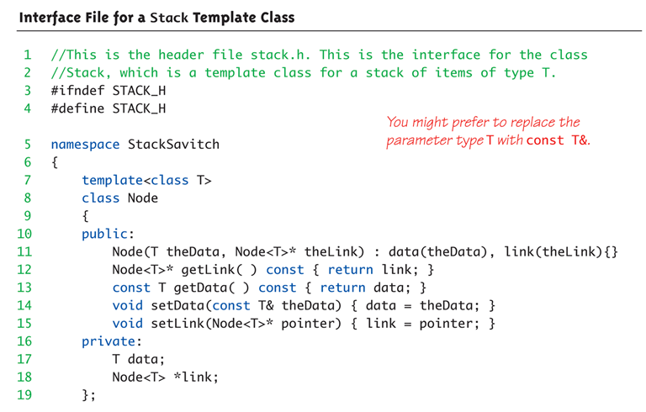
Interface File for a Stack

Slide 18
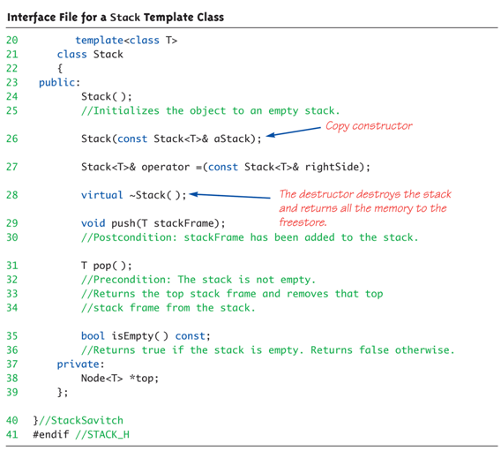
Interface File for a Stack

Slide 19
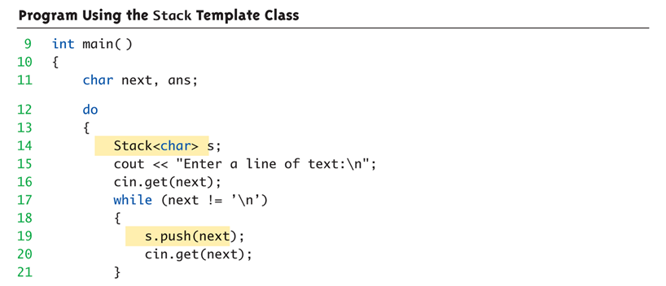
Stack Template Class Driver

Slide 20
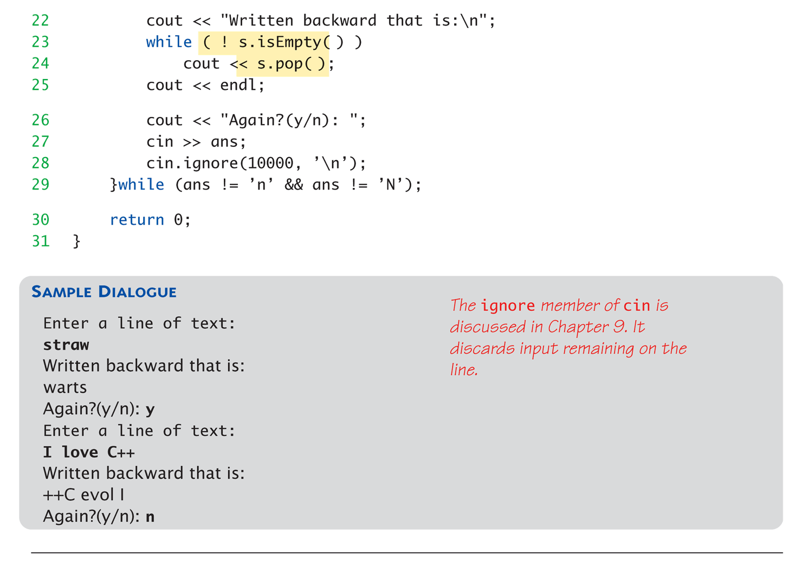
Stack Template Class Driver

Slide 21
Stack Practice
Default constructor should set top to NULL
General constructor should set top to input parameter
Pop() needs to
return data type T
Advance top to next item in list
Delete the top node
Push() needs to
Allocate a new Node<T> with data value of type T
Set top to new node

Slide 22


Queues
Another common data structure:
Handles data in first-in/first-out manner (FIFO)
Items inserted to end of list
Items removed from front
Representation of typical "line" forming
Like bank teller lines, movie theatre lines, etc.

Slide 23

Queues: FIFO
14
3
22
front
back

Slide 24
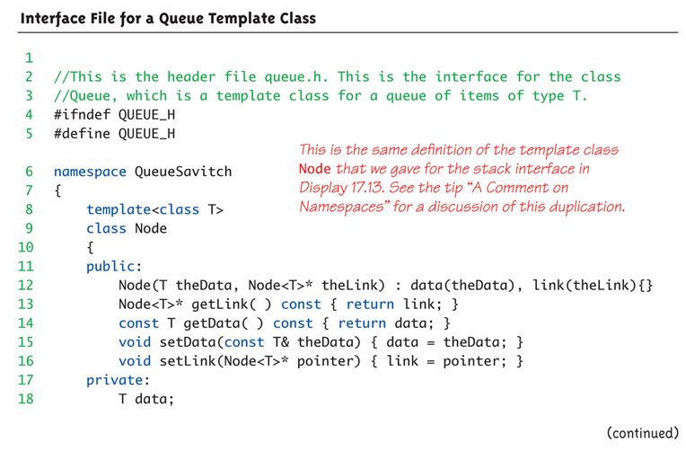
Interface File for a Queue Template Class

Slide 25
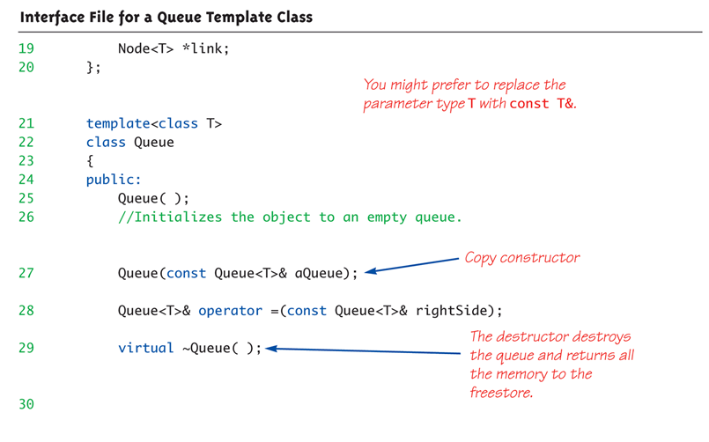
Interface File for a Queue Template Class

Slide 26
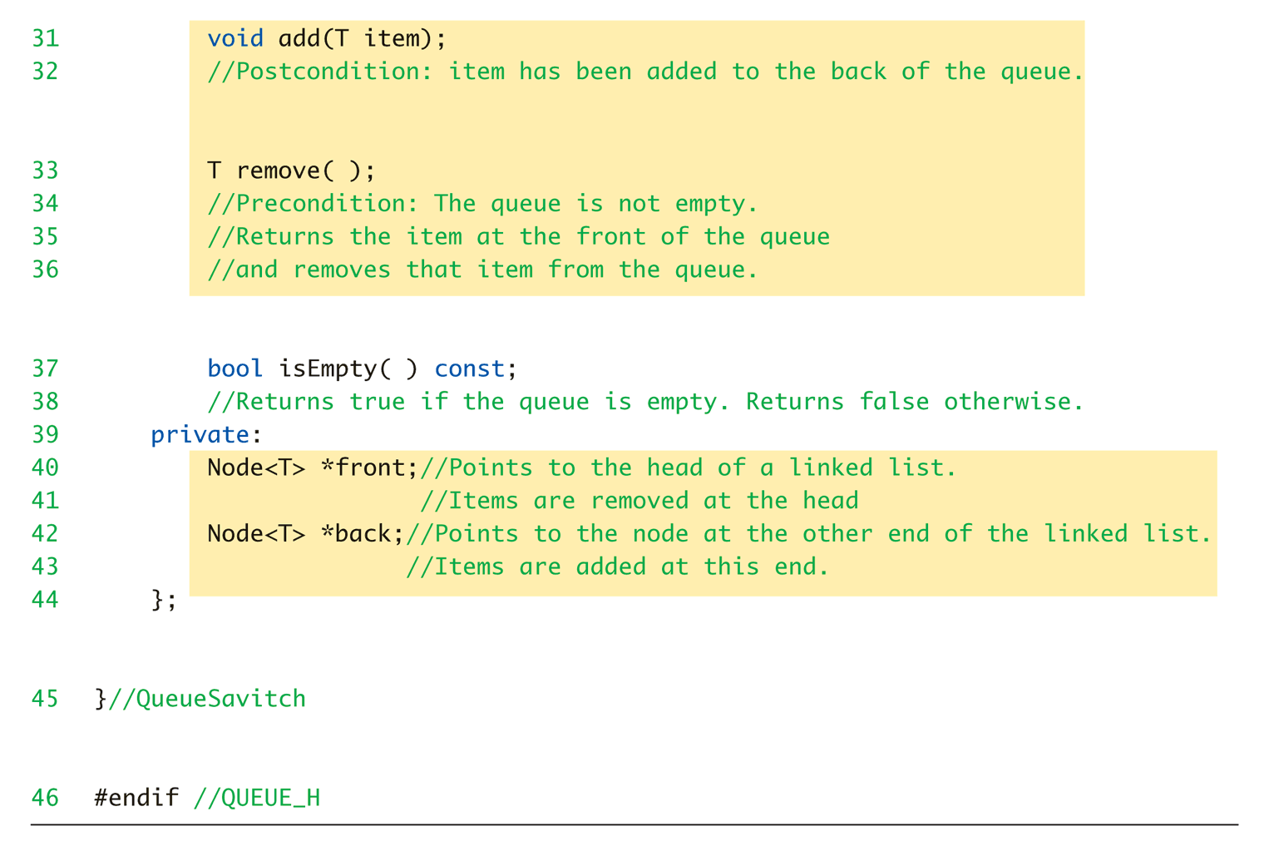
Interface File for a Queue Template Class

Slide 27
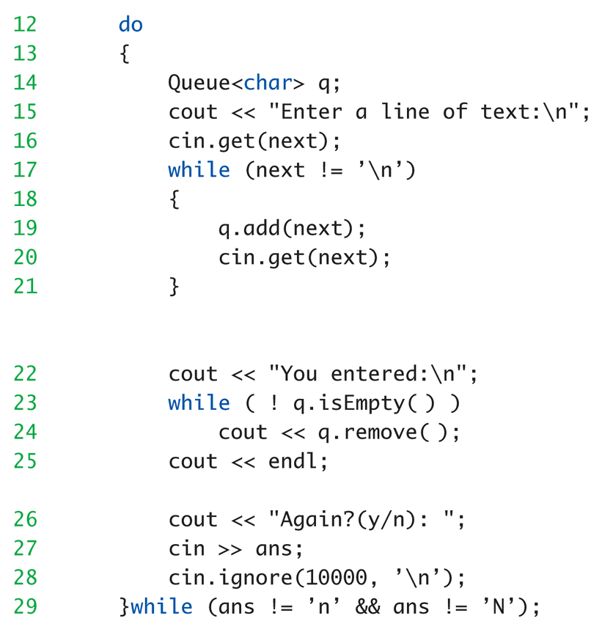
Queue Template Class Driver

Slide 28
Queue Practice
Default constructor should set front and back to NULL
Add() needs to:
Create a new Node
Set back to new Node
Remove() needs to
Advance front to next node
Delete old front node

Slide 29
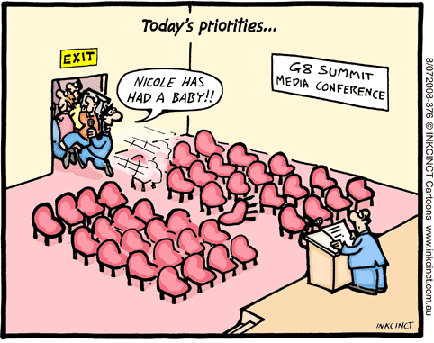
Priority Queue
20
9
9
4
1
food
TV
HW
call home
clean room
front

Slide 30
Key Takeaways
Remember to handle data structure copy and delete operations
Stacks and Queues
Tweaks on general linked list concept
Ideal for specific processing tasks (LIFO and FIFO)

